Slide 1
Lectures on HPC/Parallel Computing Lecture 2
Andrew Pensoneault

Slide 2
Overview
SFTP Client
Transfering Code
Running MATLAB code on the cluster

Slide 3
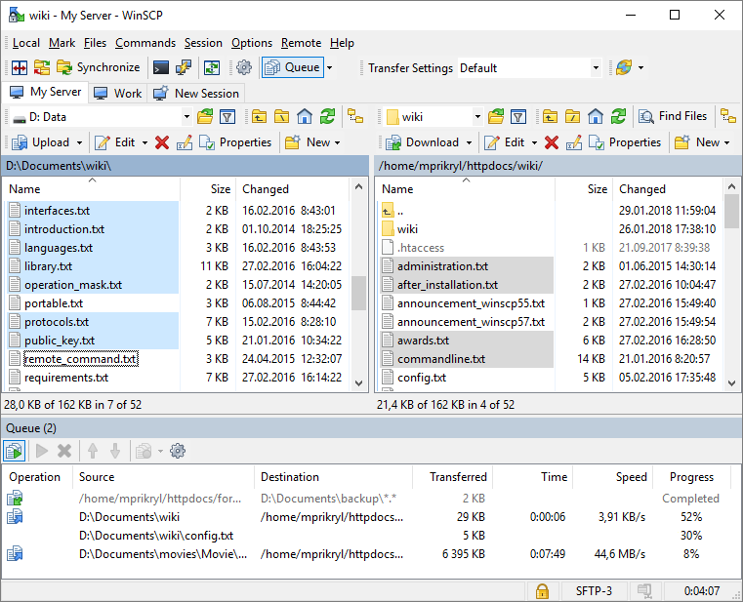
SFTP Client
SFTP allows us to transfer files from our local computer to the cluster
One SFTP client for Windows is WinSCP (https://winscp.net/eng/index.php)
Another SFTP client which works for Windows/Mac/Linux is Filezilla (https://filezilla-project.org/)
We can edit our files locally and move them onto the cluster after

Slide 4
Running your code
To run a matlab script named “main.m”, inside an sh file in the same directory write the following command
module load matlab
matlab -nodisplay -nosplash -r ‘main’
To run a python script named “main.py”, inside an sh file in the same directory write the following command
module load python
python main.py
To run a Julia script named “main.jl”, inside an sh file in the same directory write the following commands
module load julia
julia main.jl

